Slide 1
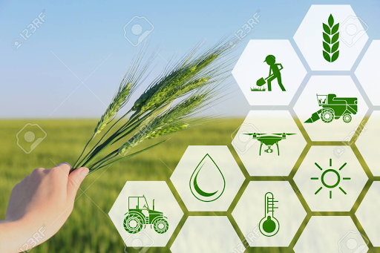

AIML Group Lab Team 6
Happy Plant

Slide 2
Agenda
Problem Statement
Introduction to Team
Response to the Questionnaire (Refer Abstract)
Business Applications, Post course
Q & A

Slide 3
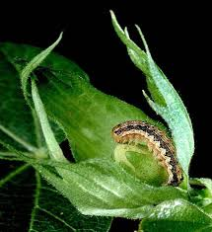
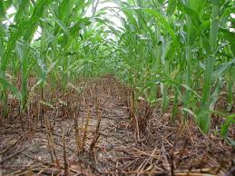
Problem Statement
68% average annual loss of crop production in India is due to the following:
Diseases (16%)
Weeds (34%)
Pests (18%)

Slide 4
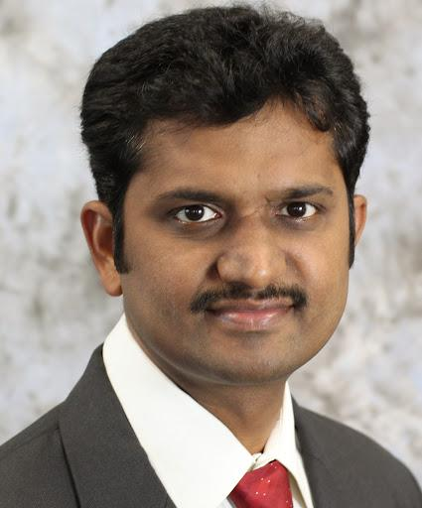

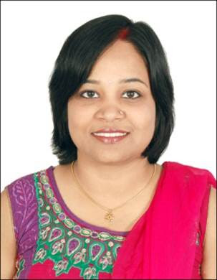


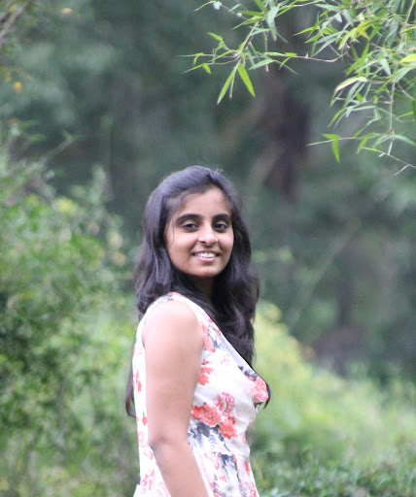
Happy Plant
Srinivas - Harman
Abins - Mindtree
Priyanka - Visa
Amitabh – Sigma
Tajuddin – Kinara Capital
Yashaswi – Intuit

Slide 5
Data Sources
1. Plant disease labelled pictures
2. Soil, Temperature, Sunlight, Water vs Plant growth data
3. Plant & weed labelled pictures
https://www.uaex.edu/yard-garden/resource-library/diseases/

Slide 6
Data Collection & Pre-processing
Data Collection
Photos of Plants and Leaves
Temperature
Humidity
Soil Moisture
Air Quality
Pre-Processing
Image Resize
Image Segmentation
Data Augmentation
Challenges:
Accuracy and availability of sensor data
Availability of disease labelled data only for certain crop types

Slide 7
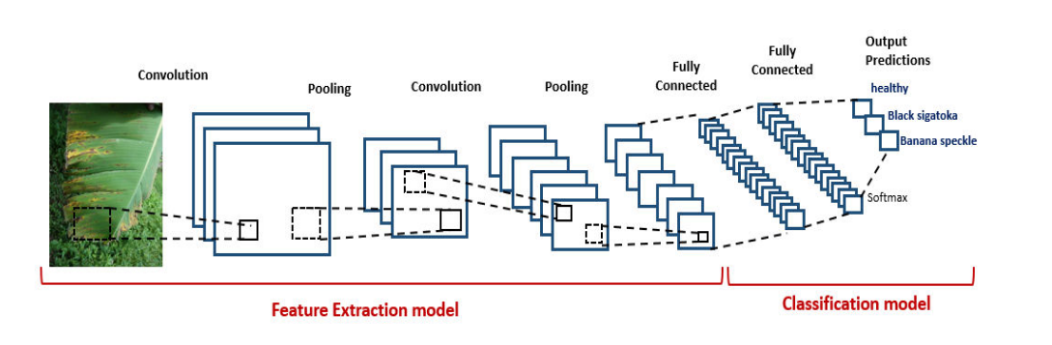
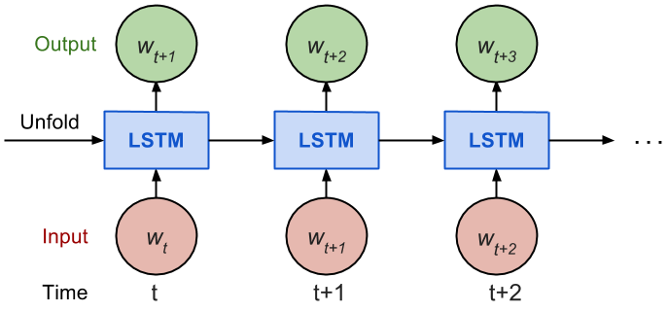
Algorithm – CNN & LSTM

Slide 8
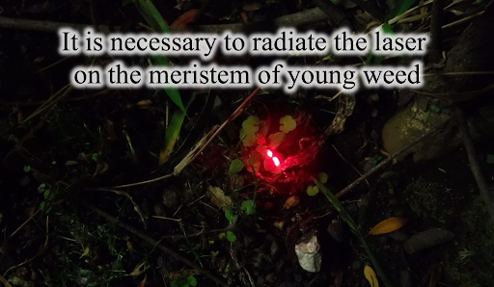
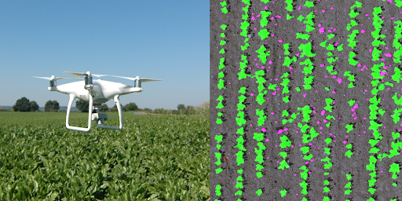
Implementation and Results
Plan for entire process of model building and experimentation with all relevant details.
Getting domain expertise in the first one month
Gather & Cleanse the data
Implement the Algorithm
Validate and Test
Results
Early detection of diseases to enable prompt action
Increase in crop productivity

Slide 9
Post Course
Form a start up called Happy Plant

Slide 10
Q & A

Slide 11
Thank you!

